Slide 1
Relevance Feedback
Hongning Wang
CS@UVa

Slide 2


What we have learned so far
Indexed corpus
Crawler
Ranking procedure
Research attention
Feedback
Evaluation
Doc Analyzer
(Query)
User
Query Rep
Doc Rep (Index)
Ranker
Indexer
results
Index

Slide 3


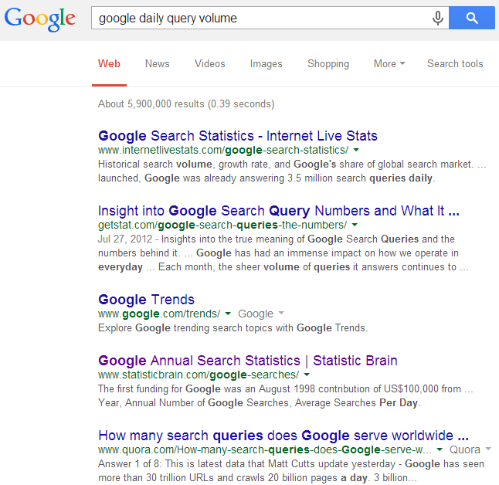
User feedback
should be
An IR system is an interactive system
Query
Information need
Feedback
GAP!
Ranked documents
Inferred information need

Slide 4
Relevance feedback
Results:
d₁ 3.5
d₂ 2.4
…
d_{k} 0.5
...
Query
Retrieval
Engine
User
judgment
Updated
query
Document
collection
Judgments:
d₁ +
d₂ -
d₃ ₊
…
d_{k} -
...
Feedback

Slide 5
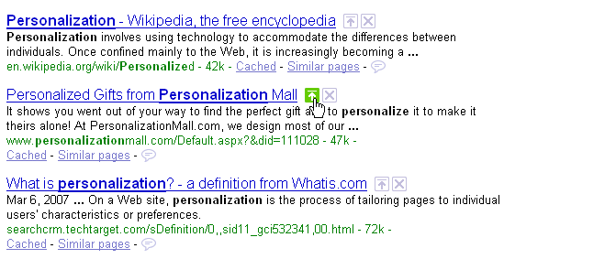
Relevance feedback in real systems
Google used to provide such functions
Guess why?
Relevant
Nonrelevant

Slide 6
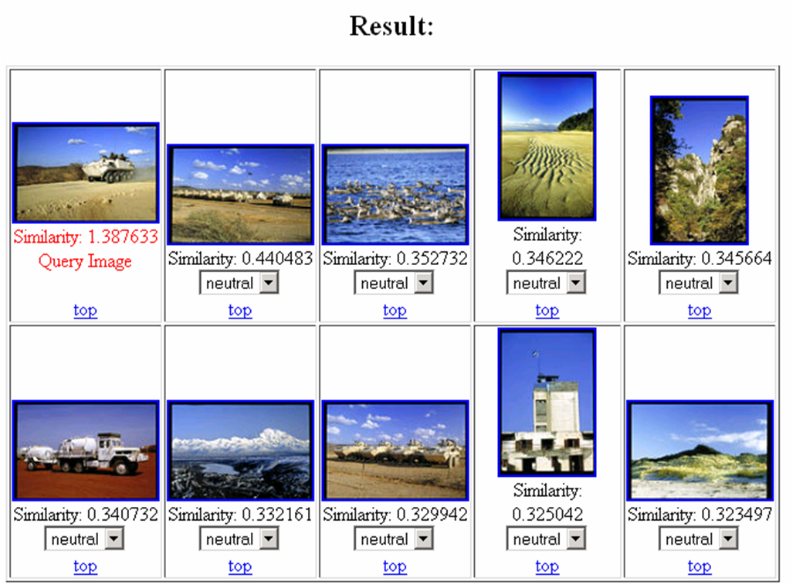
Relevance feedback in real systems
Popularly used in image search systems

Slide 7
Pseudo feedback
What if the users are reluctant to provide any feedback
Results:
d₁ 3.5
d₂ 2.4
…
d_{k} 0.5
...
Query
Retrieval
Engine
Updated
query
Document
collection
Judgments:
d₁ +
d₂ +
d₃ ₊
…
d_{k} -
...
top k
Feedback

Slide 8
Basic idea in feedback
Query expansion
Feedback documents can help discover related query terms
E.g., query=“information retrieval”
Relevant or pseudo-relevant docs may likely share very related words, such as “search”, “search engine”, “ranking”, “query”
Expand the original query with such words will increase recall and sometimes also precision

Slide 9
Basic idea in feedback
Learning-based retrieval
Feedback documents can be treated as supervision for ranking model update
Will be covered in the lecture of “learning-to-rank”

Slide 10
Feedback techniques
Feedback as query expansion
Step 1: Term selection
Step 2: Query expansion
Step 3: Query term re-weighting
Feedback as training signal
Will be covered later

Slide 11
Relevance feedback in vector space models
General idea: query modification
Adding new (weighted) terms
Adjusting weights of old terms
The most well-known and effective approach is Rocchio ^{[Rocchio 1971]}

Slide 12
Illustration of Rocchio feedback
-
-
-
-
-
-
+
+
+
-
-
+
-
-
-
-
+
+
q
-
q
-
+
+
+
-
-
+
+
-
-
+
+
+
+
+
-
+
+
+
-
-
-
-
-
-
-
-

Slide 13
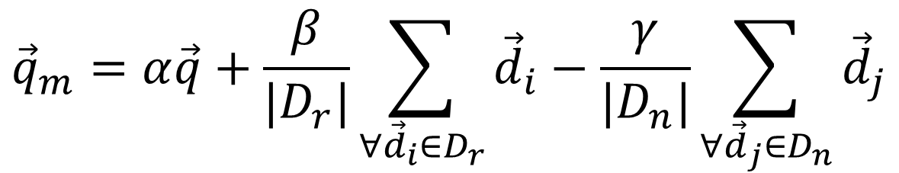
Formula for Rocchio feedback
Standard operation in vector space
Parameters
Modified query
$${\vec{q}}_{m}=α\vec{q}+\frac{β}{|D_{r}|}\sum_{∀{\vec{d}}_{i}∈D_{r}}{{\vec{d}}_{i}}−\frac{γ}{|D_{n}|}\sum_{∀{\vec{d}}_{j}∈D_{n}}{{\vec{d}}_{j}}$$
Original query
Rel docs
Non-rel docs

Slide 14
Rocchio in practice
Negative (non-relevant) examples are not very important (why?)
Efficiency concern
Restrict the vector onto a lower dimension (i.e., only consider highly weighted words in the centroid vector)
Avoid “training bias”
Keep relatively high weight on the original query weights
Can be used for relevance feedback and pseudo feedback
Usually robust and effective

Slide 15
Feedback in probabilistic models
Rel. doc model
Classic Prob. Model
NonRel. doc model
Language Model
“Rel. query” model
(q₁,d₁,1)
(q₁,d₂,1)
(q₁,d₃,1)
P(D|Q,R=1)
Initial retrieval:
- P(D|Q,R=1): query as rel doc
- P(Q|D,R=1): doc as rel query
Feedback:
- P(D|Q,R=1) can be improved for the current query and future doc
- P(Q|D,R=1) can be improved for the current doc and future query
(q₁,d₄,0)
(q₁,d₅,0)
(q₃,d₁,1)
P(D|Q,R=0)
Parameter
Estimation
(q₄,d₁,1)
(q₅,d₁,1)
(q₆,d₂,1)
(q₆,d₃,0)
P(Q|D,R=1)

Slide 16
Document generation model
Terms occur in doc
Terms do not occur in doc
Important tricks
Assumption: terms not occurring in the query are equally likely to occur in relevant and nonrelevant documents, i.e., p_{t}=u_{t}
document | relevant(R=1) | nonrelevant(R=0)
term present A_{i}=1 | p_{i} | u_{i}
term absent A_{i}=0 | 1-p_{i} | 1-u_{i}

Slide 17
Robertson-Sparck Jones Model (Robertson & Sparck Jones 76)
(RSJ model)
Two parameters for each term A_{i}:
p_{i} = P(A_{i}=1|Q,R=1): prob. that term A_{i} occurs in a relevant doc
u_{i} = P(A_{i}=1|Q,R=0): prob. that term A_{i} occurs in a non-relevant doc
How to estimate these parameters?
Suppose we have relevance judgments,
“+0.5” and “+1” can be justified by Bayesian estimation as priors
P(D|Q,R=1) can be improved for the current query and future doc
Per-query estimation!

Slide 18
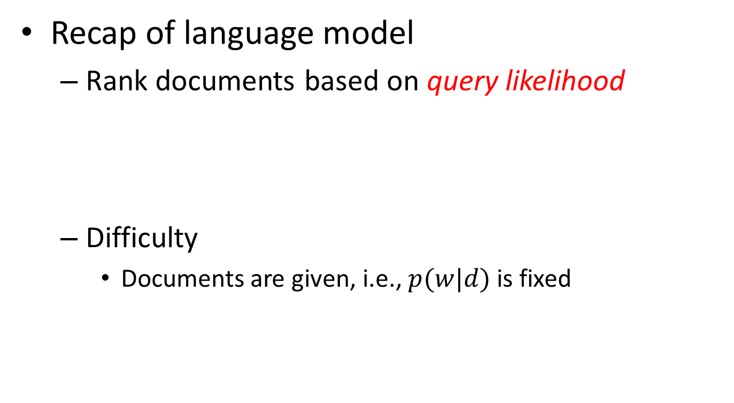
Feedback in language models
Recap of language model
Rank documents based on query likelihood
Difficulty
Documents are given, i.e., $p(w|d)$ is fixed
Document language model

Slide 19
Feedback in language models
Approach
Introduce a probabilistic query model
Ranking: measure distance between query model and document model
Feedback: query model update
Q:Back to vector space model?
A: Kind of, but in different perspective.

Slide 20
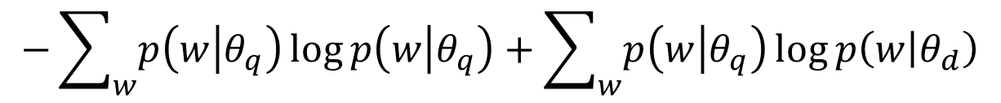

Kullback-Leibler (KL) divergence based retrieval model
Probabilistic similarity measure
$sim\left(q;d\right)∝−KL(θ_{q}|\left|θ_{d}\right)$
$$−\sum_{w}{p\left(w | θ_{q}\right)\log{p\left(w | θ_{q}\right)}}+\sum_{w}{p\left(w | θ_{q}\right)\log{p\left(w | θ_{d}\right)}}$$
Query-specific quality, ignored for ranking
Query language model, need to be estimated
Document language model, we know how to estimate

Slide 21

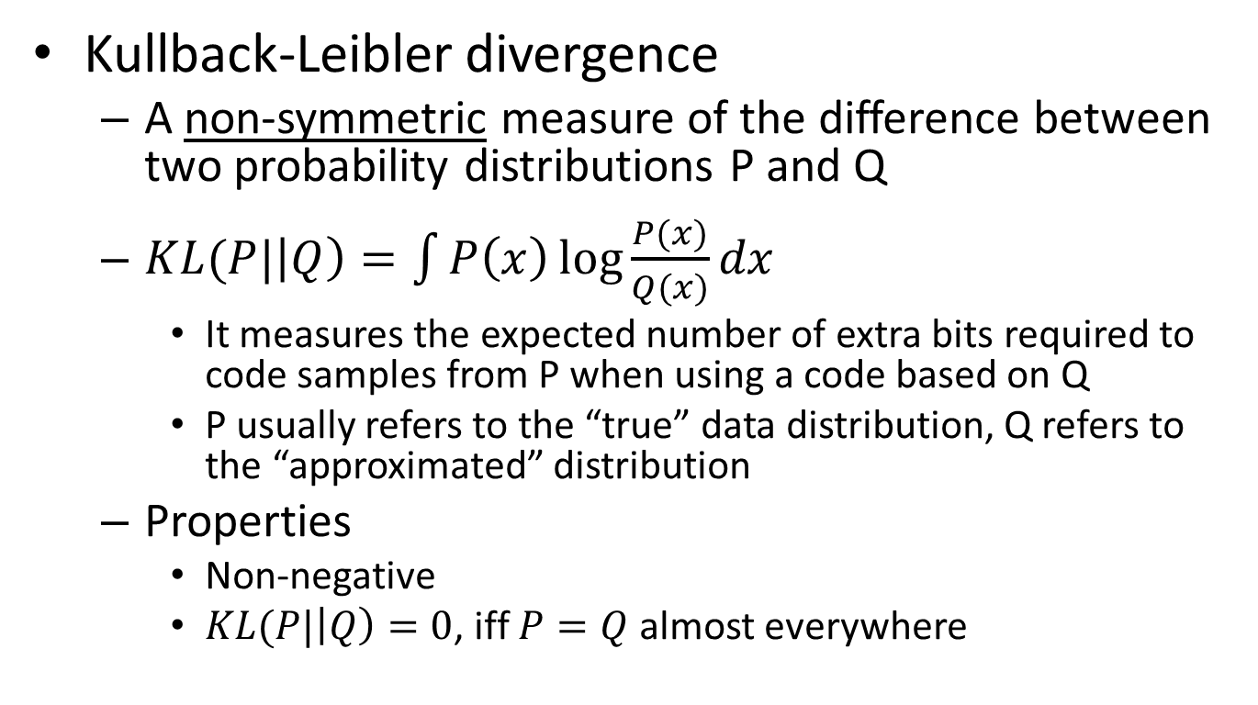
Background knowledge
Kullback-Leibler divergence
A non-symmetric measure of the difference between two probability distributions P and Q
$KL(P|\left|Q\right)=\int{P\left(x\right)\log{\frac{P(x)}{Q(x)}}dx}$
It measures the expected number of extra bits required to code samples from P when using a code based on Q
P usually refers to the “true” data distribution, Q refers to the “approximated” distribution
Properties
Non-negative
$KL(P|\left|Q\right)=0$, iff $P=Q$ almost everywhere
Explains why $sim\left(q;d\right)∝−D(θ_{q}|\left|θ_{d}\right)$

Slide 22
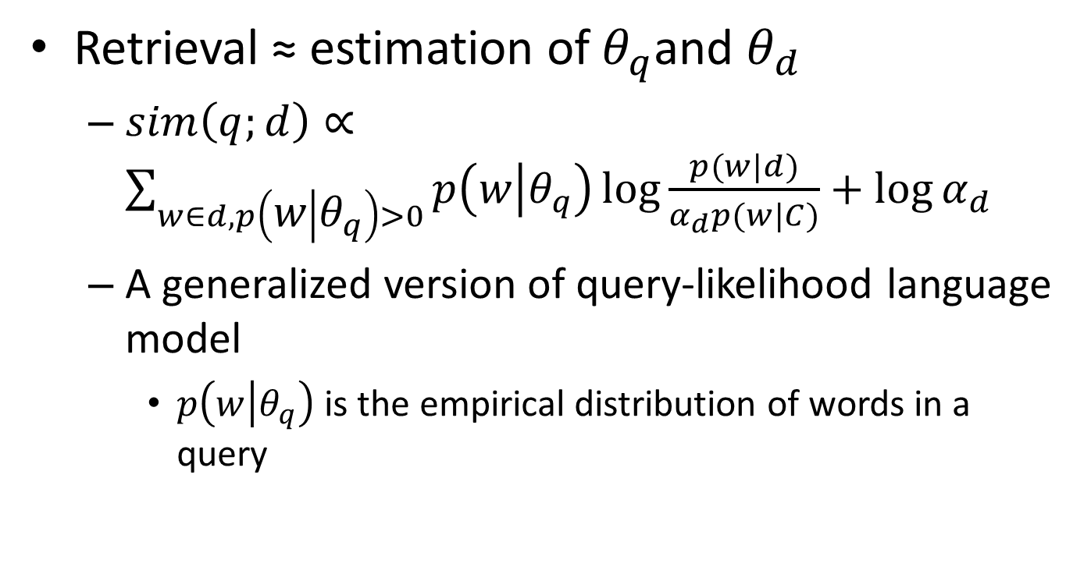
Kullback-Leibler (KL) divergence based retrieval model
Retrieval ≈ estimation of $θ_{q}$and $θ_{d}$
$sim\left(q;d\right)∝\sum_{w∈d,p\left(w | θ_{q}\right)>0}{p\left(w | θ_{q}\right)\log{\frac{p(w|d)}{α_{d}p(w|C)}}+\log{α_{d}}}$
A generalized version of query-likelihood language model
$p\left(w | θ_{q}\right)$ is the empirical distribution of words in a query
same smoothing strategy

Slide 23
Feedback as model interpolation
Document D
Results
Query Q
Key: estimate the feedback model
Feedback Docs
F={d₁, d₂ , …, d_{n}}
α=0
α=1
Generative model
No feedback
Full feedback
Q: Rocchio feedback in vector space model?
A: Very similar, but in different interpretation.

Slide 24



Feedback in language models
Feedback documents
protect passengers, accidental/malicious harm, crime, rules

Slide 25
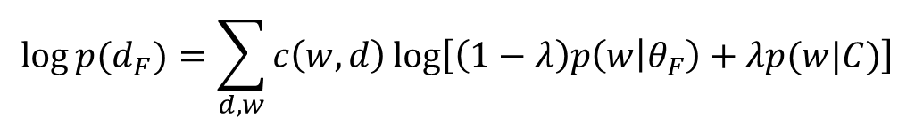

Generative mixture model of feedback
Background words
F={d₁, …, d_{n}}
λ
P(w| C)
P(feedback)
Topic words
1-λ
P(w| θ_{F} )
$$\log{p(d_{F})=\sum_{d,w}{c\left(w,d\right)\log\left[\left(1−λ\right)p\left(w | θ_{F}\right)+λp(w|C)\right]}}$$
λ = Noise ratio in feedback documents
Maximum Likelihood
$${ \overline{θ}}_{F}=argmax_{θ}\log{p(d_{F})}$$

Slide 26
How to estimate θ_{F}?
the 0.2
a 0.1
we 0.01
to 0.02
…
flight 0.0001
company 0.00005
…
fixed
Feedback
Doc(s)
Known
Background
p(w|C)
λ=0.7
ML
Estimator
Unknown
query topic
p(w|θ_{F})=?
“airport security”
…
accident =?
regulation =?
passenger=?
rules =?
…
λ=0.3
Suppose, we know the identity of each word
; but we don’t...

Slide 27
Appeal to EM algorithm
Identity (“hidden”) variable: z_{i} ∈{1 (background), 0(topic)}
z_{i}
1
1
1
1
0
0
0
1
0
...
Suppose the parameters are all known, what’s a reasonable guess of z_{i}?
- depends on λ (why?)
- depends on p(w|C) and p(w|θ_{F}) (how?)
the
paper
presents
a
text
mining
algorithm
the
paper
...
E-step
M-step
Why in Rocchio we did not distinguish a word’s identity?

Slide 28
A toy example of EM computation
Expectation-Step:
Augmenting data by guessing hidden variables
Maximization-Step
With the “augmented data”, estimate parameters using maximum likelihood
Assume λ=0.5

Slide 29
Example of feedback query model
Open question: how do we handle negative feedback?
Query: “airport security”
Pesudo feedback with top 10 documents
λ=0.7
λ=0.9

Slide 30
Keep this in mind, we will come back
fixed
the 0.2
a 0.1
we 0.01
to 0.02
…
text 0.0001
mining 0.00005
…
Observed
Doc(s)
Known
Background
p(w|C)
λ=0.7
ML
Estimator
Unknown
query topic
p(w|θ_{F})=?
“Text mining”
…
text =?
mining =?
association =?
word =?
…
λ=0.3

Slide 31
What you should know
Purpose of relevance feedback
Rocchio relevance feedback for vector space models
Query model based feedback for language models

